Slide 1
ANALYSIS IN BIG DATA USING HADOOP TO INVESTIGATE H1B VISA APPLICATIONS
JEMIMAH.C guided by : Ms.santhanalakshmi
tech mentor
bigdata with hadoop
Project title : H1B

Slide 2
CONTENTS
S.NO | CONTENT
1 | OBJECTIVE
2 | INTRODUCTION
3 | PROBLEM DEFINITION
4 | PROPOSED WORK
5 | LIST OF MODULES
6 | SNAPSHOTS
7 | GRAPH
8 | CONCLUSION
9 | FUTURE ENHANCEMENT

Slide 3
OBJECTIVE
To analyse the HIB visa applications between the years 2011 - 2015.

Slide 4
INTRODUCTION [1]
DOMAIN:BIGDATA
DEFINITION:
Big data refers to a collection of data sets or information too large and complex to be processed by standard tools.
CHARACTERISTICS:
-Iterative
-Flexible
-Contextual
-Real Time Optimization
-Business Strategy

Slide 5
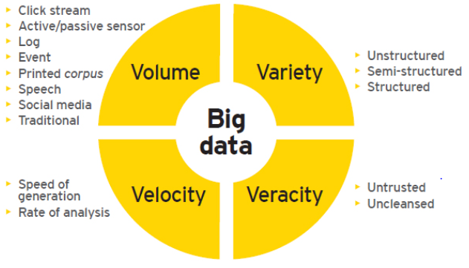
INTRODUCTION [2]

Slide 6
INTRODUCTION [3]
APPLICATIONS OF BIGDATA:
Analysis:
-number of petitions
-top 5 locations,job titles,employers
-top 10 most populars job positions
-top 10 highest success in petitions
-average wage for each job each year

Slide 7
PROBLEM DEFINITION
To perform analysis on H1B visa applications between the years 2011 - 2015.

Slide 8
PROPOSED WORK
To find:
1 a) Is the number of petitions with Data Engineer job title increasing over time?
b) Find top 5 job titles who are having highest growth in applications.
2 a) Which part of the US has the most Data Engineer jobs for each year?
b) find top 5 locations in the US who have got certified visa for each year.
3)Which industry has the most number of Data Scientist positions?
4)Which top 5 employers file the most petitions each year?
5) Find the most popular top 10 job positions for H1B visa applications for each year?
6) Find the percentage and the count of each case status on total applications for each year. Create a graph depicting the pattern of All the cases over the period of time.
7) Create a bar graph to depict the number of applications for each year
8) Find the average Prevailing Wage for each Job for each Year (take part time and full time separate)
9) Which are top ten employers who have the highest success rate in petitions?
10) Which are the top 10 job positions which have the highest success rate in petitions?

Slide 9
LIST OF TOOLS AND FRAMEWORKS
Hadoop
MapReduce
Hive
Pig
Sqoop

Slide 10
HADOOP
Hadoop is an open source implementation of MapReduce coded and released in Java by Apache. The Hadoop implementation of MapReduce uses the Hadoop Distributed File System (HDFS) as its underlying layer rather than GFS.
The Hadoop core is divided into two fundamental layers:
Map Reduce Engine
HDFS
The MapReduce engine is the computation engine running on top of HDFS as its data storage manager.

Slide 11
HDFS
HDFS is a distributed file system inspired by GFS that organizes files and stores their data on a distributed computing system. HDFS has a master/slave architecture including:
Name Node (master)
Data Node (slave)

Slide 12
MAPREDUCE
The topmost layer of Hadoop is the MapReduce engine that manages the data flow and control flow of MapReduce jobs over distributed computing systems. The MapReduce engine follows a master/slave architecture consisting of:
Job Tracker(Master)
Task Tracker(Slave)

Slide 13
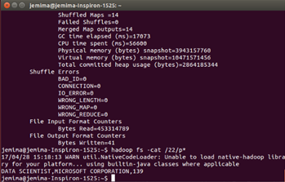
MAPREDUCE QUERY

Slide 14
YARN
Yet Another Resource Negotiator is used in Hadoop version 2 where not only MapReduce but also other tools can be run on it. It contains
Resource Manager
Node Manager
Application Master
Container

Slide 15
HIVE
Hive provides an SQL-like interface to hadoop.
Hive is a hadoop data warehouse system.
Using hive we can access data easily and create summarization.
We can carry out analysis of large data in hadoop using pig.
Hive is a top level apache project.

Slide 16
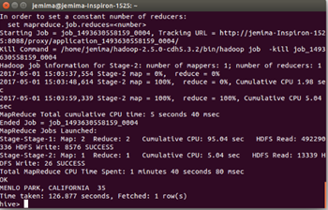
HIVE QUERY

Slide 17
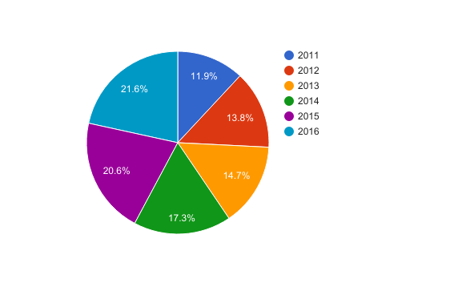
GRAPH

Slide 18
PIG
Pig is a dataflow language written in java.
It allows users to specify explicit sequence of steps for data processing.
It internally chains multiple Map-Reduce jobs for executing data flows.
It implements Map-Reduce design patterns.
It supports relational model but not strongly typed.
It generates Map-Reduce program on execution for pig operators.
It optimizes Map-reduce execution for a given data flow.
Provides extensibility through User defined Functions.
It increases programmer productivity.
It minimizes the learning curve for new developers.
It reduces duplication of programming effort.
It opens the Map-Reduce programming power to more powers.
It eliminates the complexity of lengthy native java programs.
It insulates form hadoop version upgrades.

Slide 19
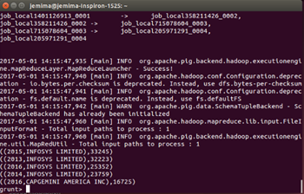
PIG QUERY

Slide 20
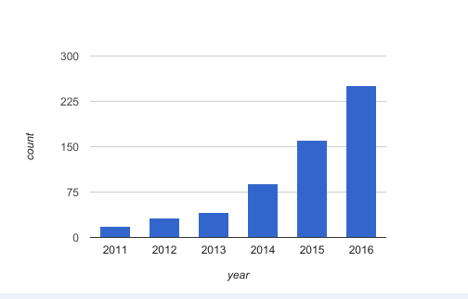
GRAPH

Slide 21
SQOOP
Sqoop is an open source software product by apache hadoop foundation and part of ecosystem.
Collection of multiple command-line tools to move data between RDBMS and hadoop.
Imports are used to populate tables in hive or hbase, in addition to hdfs.
Exports can be used to put data from hadoop into an RDBMS. It uses MapReduce for data export and import providing parallel operation in addition to fault tolerance.
It uses JDBC drivers to connect to RDBMS.

Slide 22
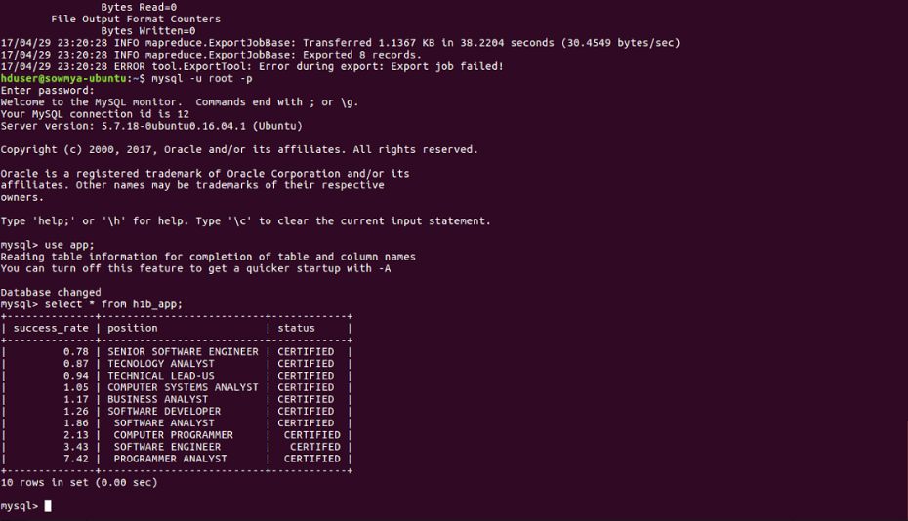
SQOOP OUTPUT

Slide 23
RESULTS
AND
DISCUSSION

Slide 24
SNAPSHOTS

Slide 25
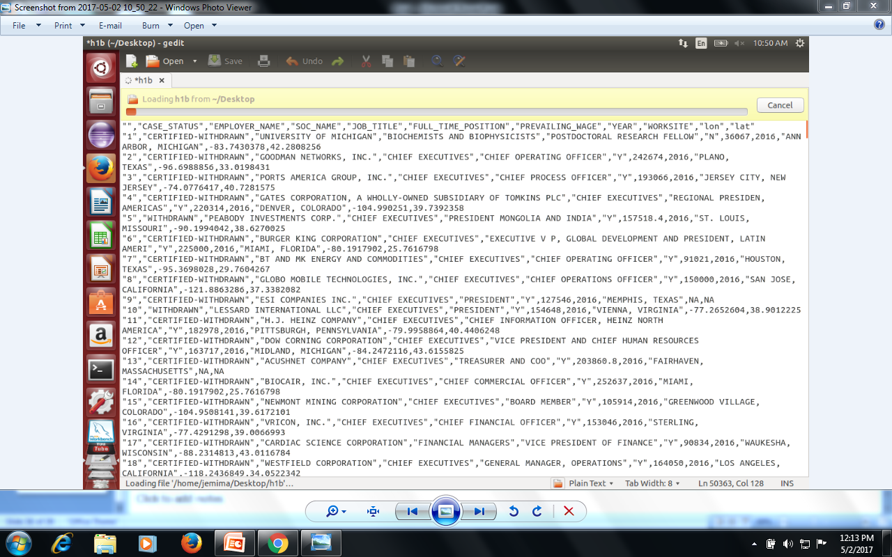
INPUTSET

Slide 26
PIG QUERIES

Slide 27
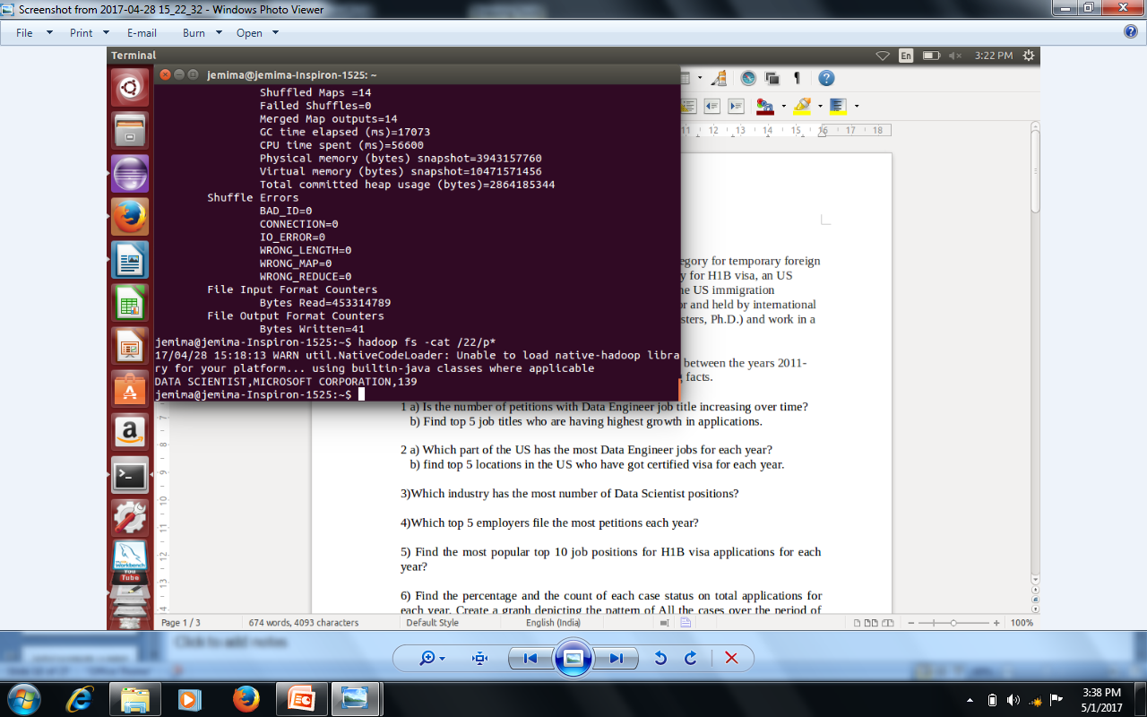
MAPREDUCE

Slide 28
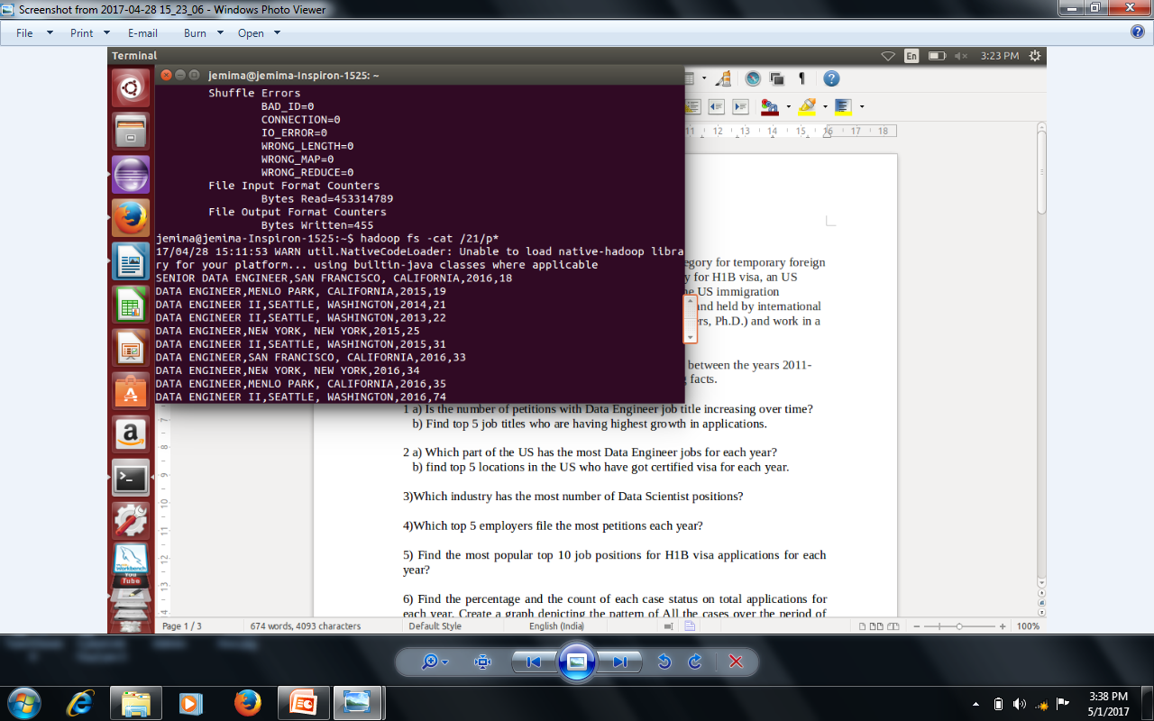
MAPREDUCE

Slide 29
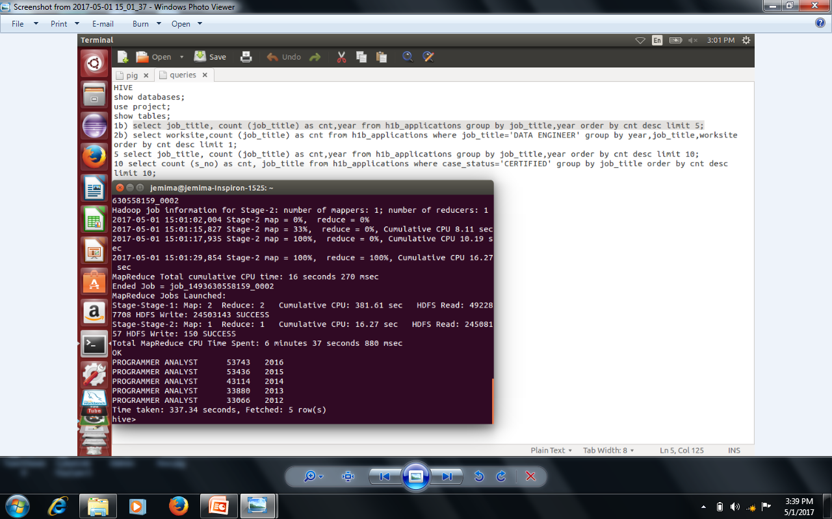
HIVE

Slide 30
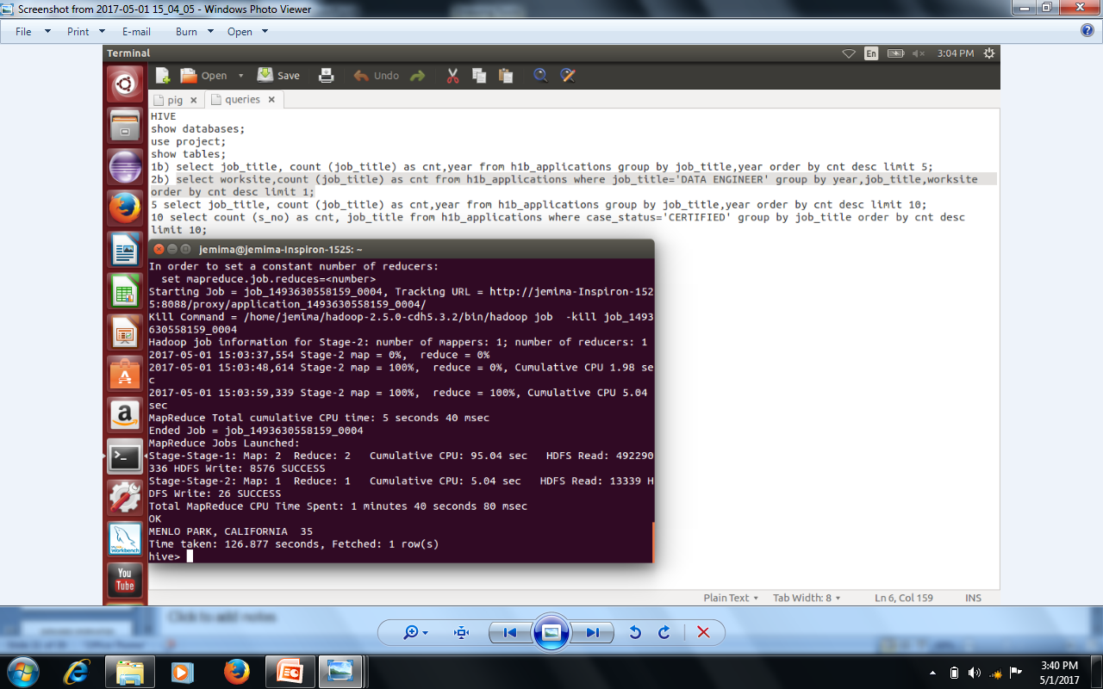
HIVE

Slide 31
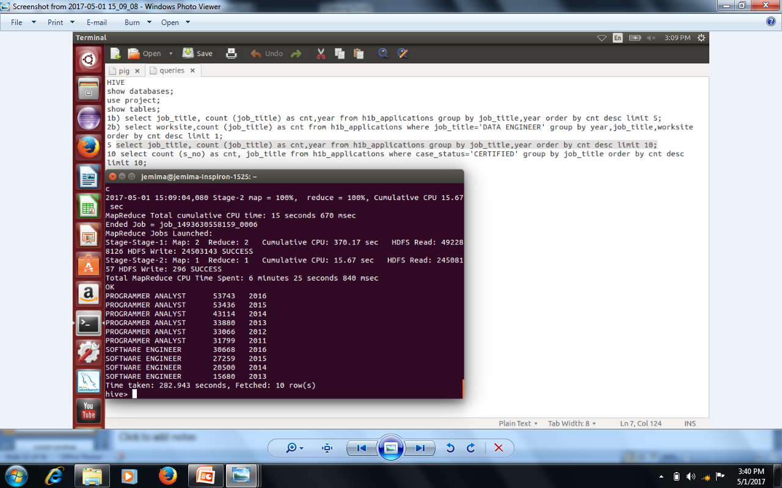
HIVE

Slide 32
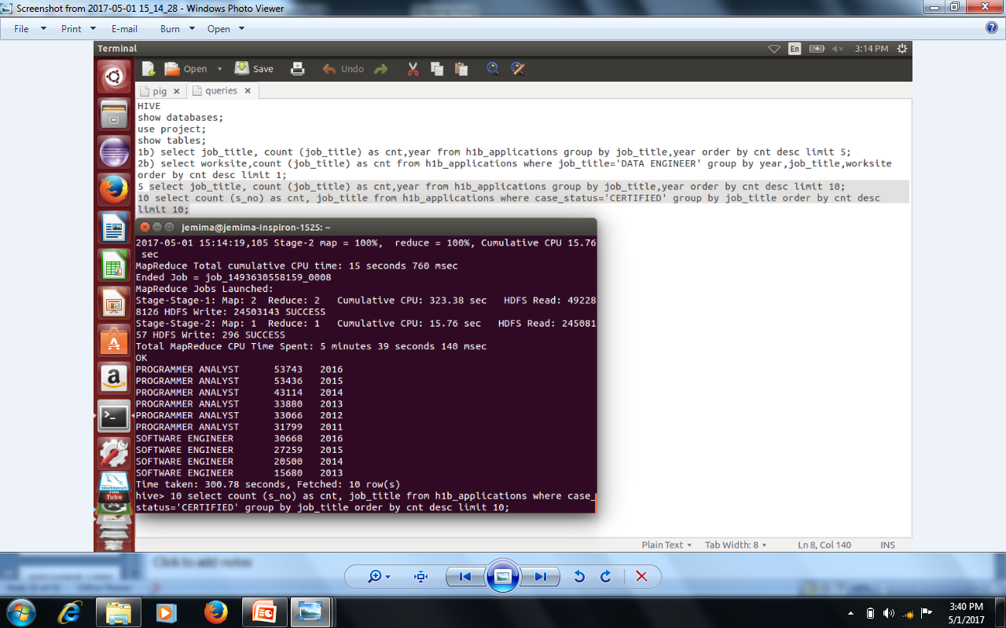
HIVE

Slide 33
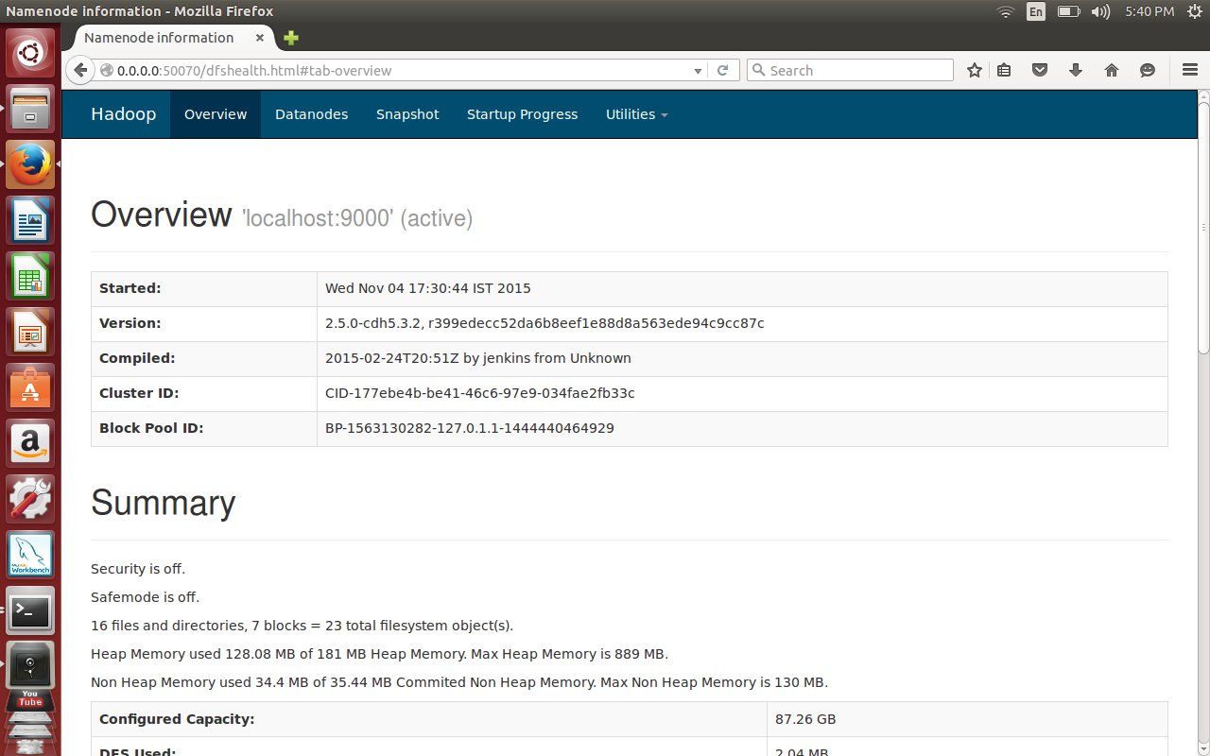
HADOOP HOMEPAGE

Slide 34
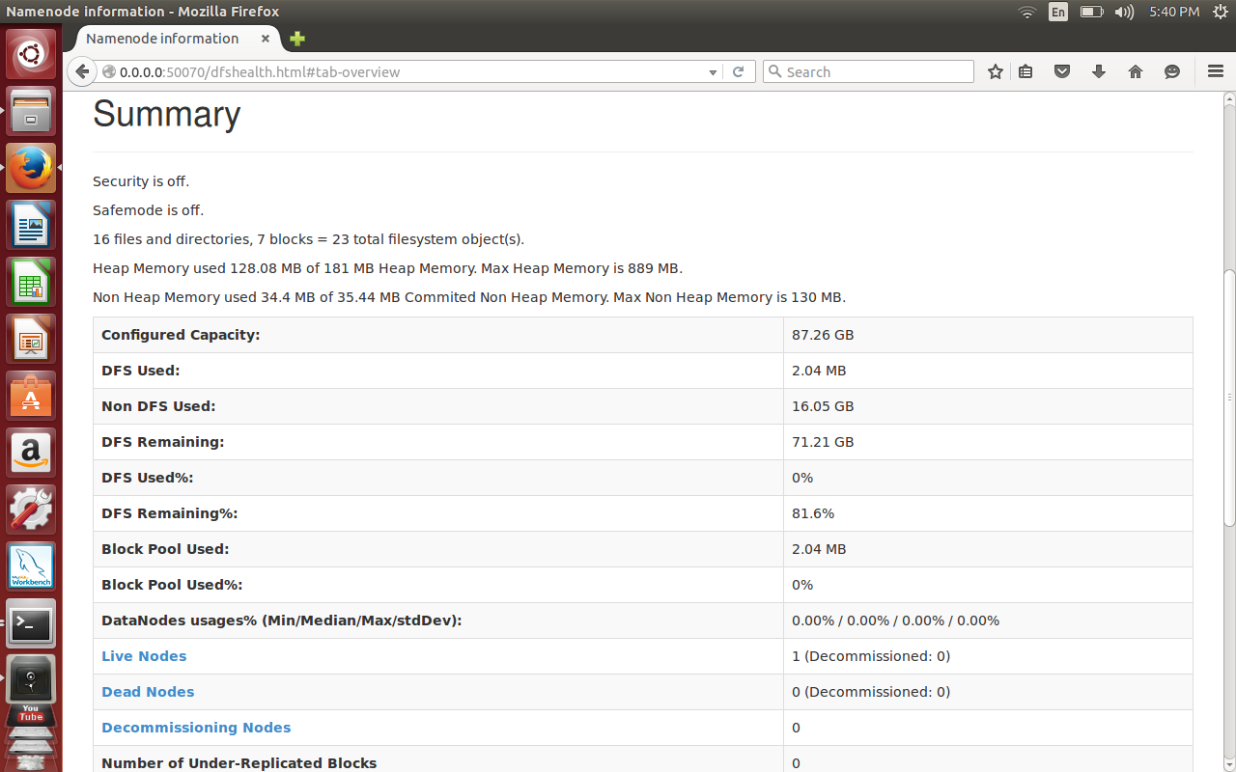
DATANODE INFORMATION

Slide 35
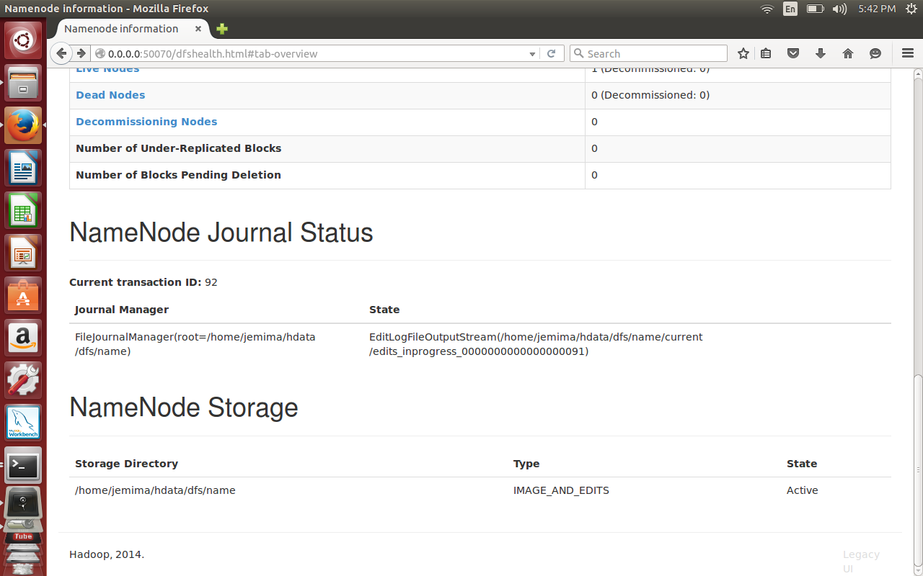
NAMENODE INFORMATION

Slide 36
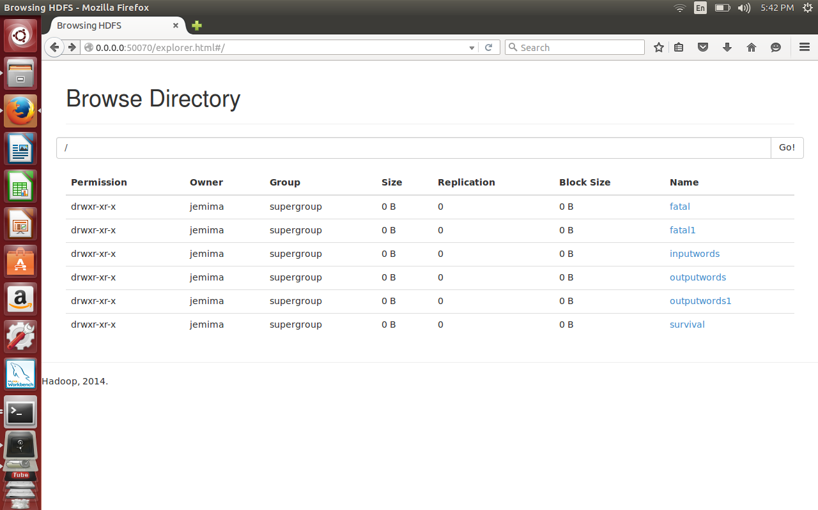
INPUT FILES STORED IN HADOOP

Slide 37
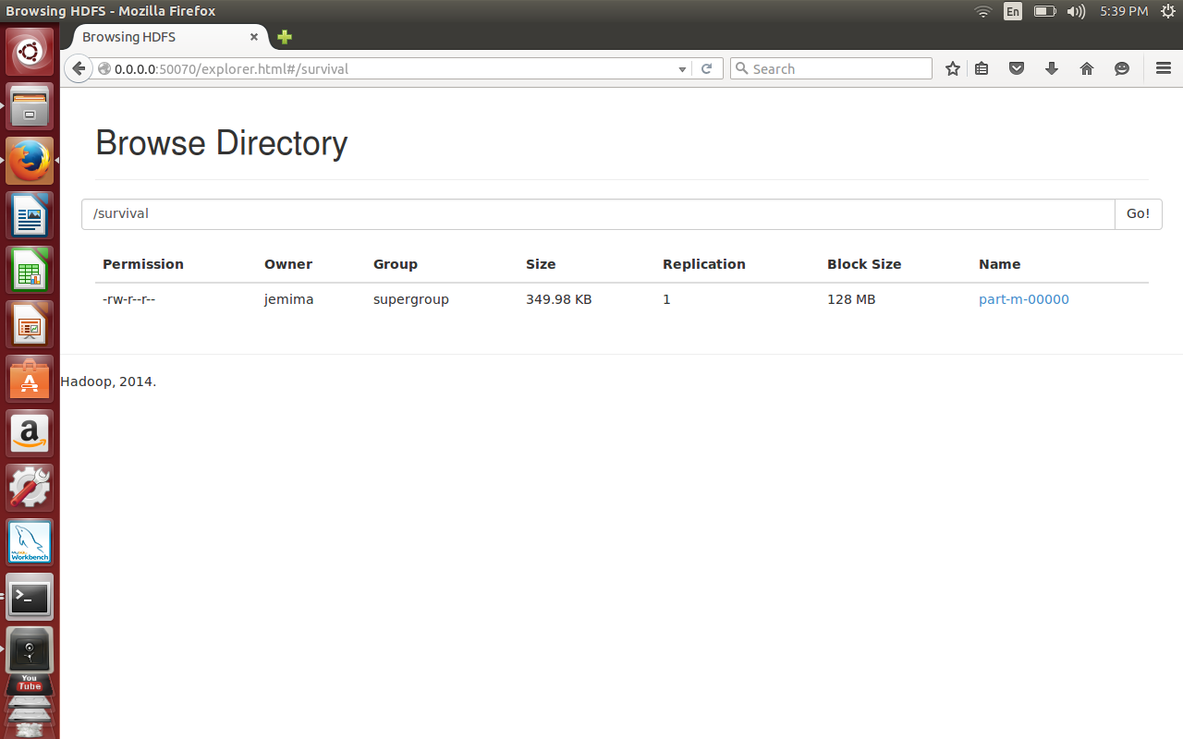
OUTPUT FILE EXECUTED IN HADOOP

Slide 38
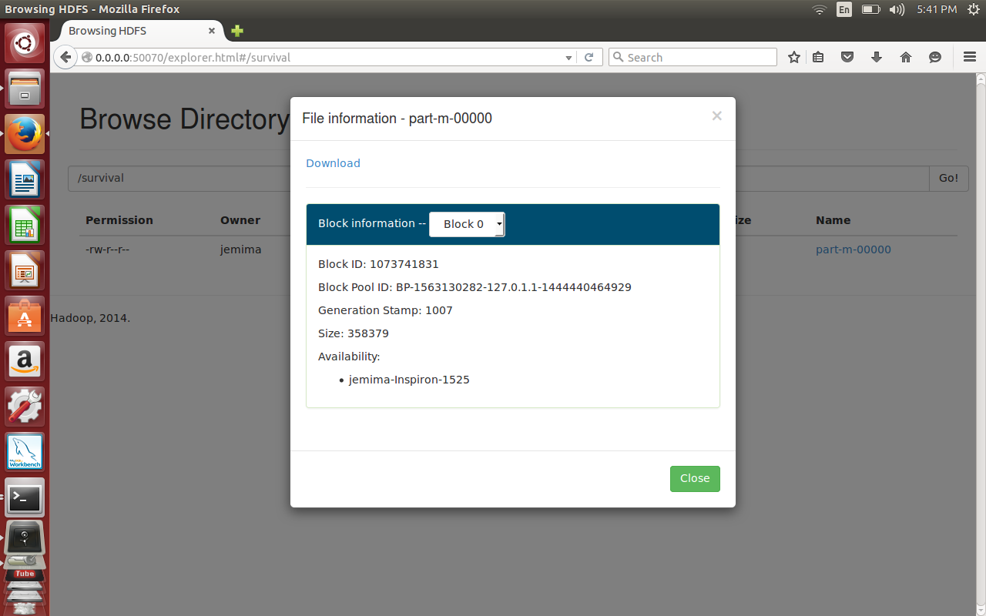
OUTPUT FILE INFORMATION

Slide 39
CONCLUSION
Top job locations, job positions are found.
Statistical analysis are depicted in graphs.
The count of petitions can be found.
The average wage for each job can be calculated.
The top ten employers for who have the highest success rate can be detected.
Similar steps can be for other data analysis also.

Slide 40
FUTURE ENHANCEMENT
Analysis could be made for the number of employers, the job positions the locations and the visa status.

